Slide 1

Introduction To
Lua

Slide 2
COURSE TIMELINE
Programming Projects with Lua
Roblox Studio Basics
Constraints Pt 1
Constraints Pt 2
Intro to Lua
Parameters
Loops & Conditionals
Functions
W1
W2
W3
W4
W5
W6
W7
W8

Slide 3

Edmodo
Resource Hub
Slides
Learning Material
Exercises/ Assignments / Quizzes
Tutorial Videos
WHEN TO CHECK
FRIDAY AFTERNOON EVERY WEEK
Communication
Directly message teachers
Post Questions
Post Screenshots of your work

Slide 4
Getting Started
Download
Lesson3_Extension.rblx
Worksheet Wk4
Lesson4.txt

Slide 5
TODAY’S LESSON
1
REVIEW: TRAMPOLINE
2
INTRODUCTION TO LUA: VARIABLES
3
CLASS ACTIVITY: CALCULATOR
4
CLASS PROJECT: RACING GAME

Slide 6
CLASS ACTIVITY
TRAMPOLINE

Slide 7

WHAT IS A VARIABLE?
102
Variables are useful for storing things that change
(i.e. things that "vary" - hence the word "variable")
Try changing fav_num to 102.
fav_num
Notes:
Let's say you’re in a big warehouse, with a lot of boxes. How will you be able to access or remember something that you put in one of the box?
LABEL THE BOX!!
Variables is like the label on the box. As humans, it is easier for us to remember a name or label than an exact block of information. Variables let us store information, recall and reuse them.

Slide 8
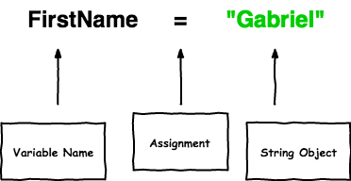
PARTS OF A VARIABLE?
Fav_num = 102

Slide 9
OUR NEW VARIABLE IN ACTION:
We're able to use our code for a new purpose, without rewriting everything:
fav_num
fav_num - 6
=> 96
fav_num * 2?
=> 204
fav_num + 21
=> 123
fav_num / 2?
=> 51

Slide 10
NO Variables VS Using Variables
4 Changes
1 Change
fav_num
fav_num
fav_num = 8
fav_num - 6
fav_num * 2
fav_num + 21
fav_num / 2
fav_num = 102
fav_num - 6
fav_num * 2
fav_num + 21
fav_num / 2
8 - 6
8 * 2
8 + 21
8 / 2
102 - 6
102 * 2
102 + 21
102 / 2

Slide 11


VARIABLES IN LUA
LOCAL VARIABLES
GLOBAL VARIABLES
Holds a variable that only exists within the scope of a file.
Holds a variable that is accessible anywhere in the project
Notes:
Global variables − All variables are considered global unless explicitly declared as a local.
Local variables − When the type is specified as local for a variable then its scope is limited with the functions inside their scope.

Slide 12
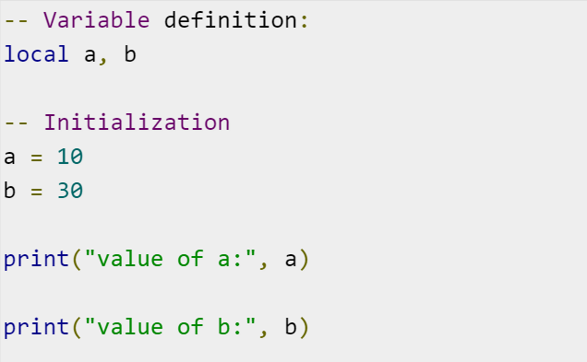
INSPIRATION FOR YOUR OBSTACLE COURSE GAME
Creates two local variables a and b
What do you think our program will print out?
Assigns the variable an integer value:
a = 10
b = 30
???

Slide 13
CLASS ACTIVITY

Slide 14

CONDITIONAL STATEMENTS
Conditions let us make decision.
First we test if the condition is met!
Then maybe we’ll do the thing
If it’s raining take an umbrella
Yep it’s raining
…... take an umbrella

Slide 15
BOOLEANS (TRUE OR FALSE)
Computers store whether a condition is met in the form of True and False
To figure out if something is True or False we do a comparison
>>> "A" in "AEIOU" >>> "Z" in "AEIOU"
>>> "a" in "AEIOU"
True
False
False

Slide 16
IF STATEMENTS
fave_num = 3
if fav_num < 10:
print("What a great number")
That’s the condition!
Is it True that fave_num is less than 10?
Well, fave_num is 3
And it’s True that 5 is less than 10
So it is True!
Notes:
*Note syntax for this is currently in Python -> change for Lua

Slide 17
ELIF STATEMENTS
elif
Means we can give specific instructions for other words
fave_num = 11
if fav_num < 10:
print("What a great number")
elif fav_num = 11:
print("I love the number 11")
else:
print("I only like numbers below 11")

Slide 18
ELSE STATEMENTS
fave_num = 15
if fav_num < 10:
print("What a great number")
elif fav_num = 11:
print("I love the number 11")
else:
print("I only like numbers below 11")
else
statements means something still happens if the if or elif statement was False

Slide 19
CLASS PROJECT

Slide 20
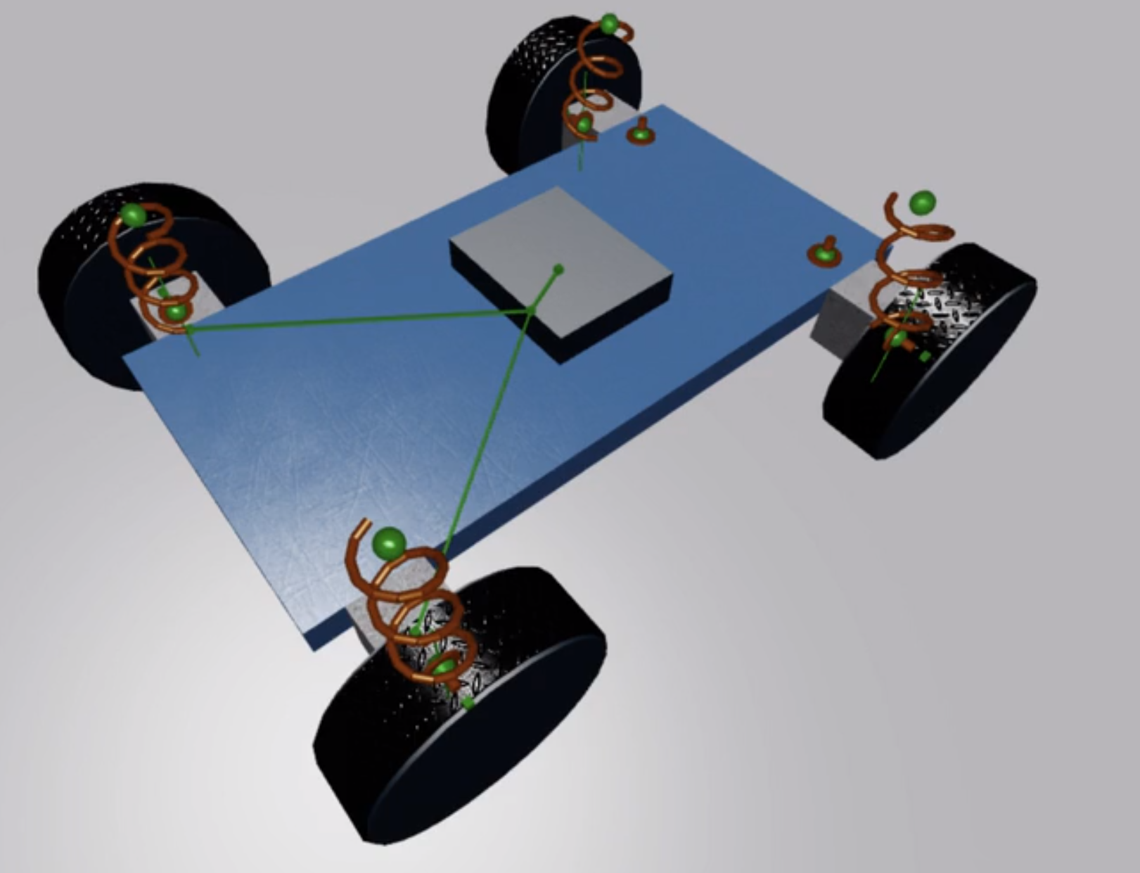
BUILDING A CAR
Game Development Process
IDEATE: We want to build a Racing Car in Roblox.
What should a car be able to do?
What are some cool features we could add?
DESIGN:
What parts can you see?
What constraints?
Where do we start?
TESTING:
When should we test?

Slide 21
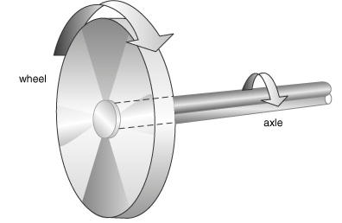
ANATOMY OF A CAR WHEEL
The edge of the wheel moves around more quickly, but with less force than the centre of the wheel.
An axle is a rod that passes through the centre of a wheel. In a road vehicle like a car the engine turns the axle to make the wheels go round.
The middle of the wheel moves around more slowly but with more turning force than the outside of the wheel.

